Slide 1
USING A DIGITAL VOLT- OHM - METER
Automotive Technology
Learning How Electricity Works

Slide 2
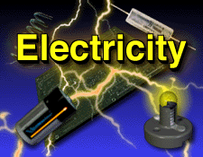
What is Electricity?

Slide 3
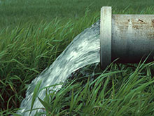
For instructional purposes electricity can be compared to water

Slide 4
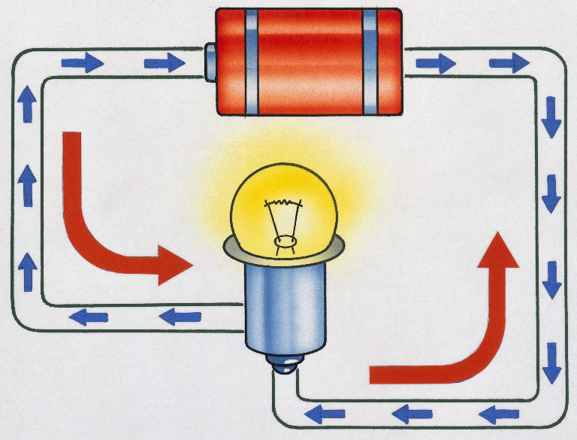
Electricity
Electricity is the flow of electrons along a conductor

Slide 5
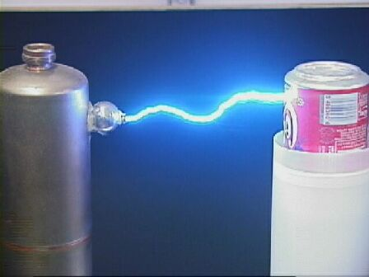
Voltage
Voltage is the force that pushes the electrons along a conductor.

Slide 6
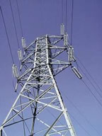
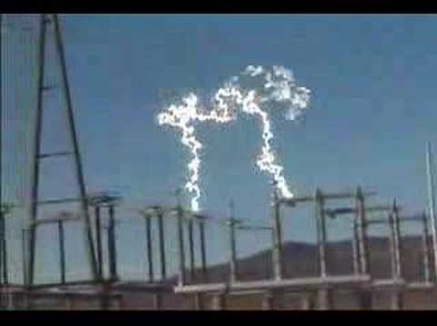
Amperage
Amperage is a measurement of the volume of electron flow.

Slide 7
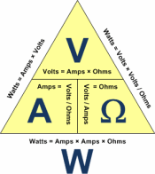
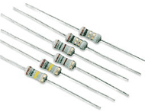

Ohms
Ohms is the measurement of resistance to the flow of electrons.
This is the WORK that is being done.
More Resistance = Less work
Less Resistance = More work

Slide 8
Direct Current Voltage
DC Volts V
All Batteries are DC, so this is the scale you will always use
for batteries!

Slide 9
Alternating Current Voltage
~
AC Volts V
Wall plugs are A/C, so this is the scale you will always use
for wall plugs!

Slide 10
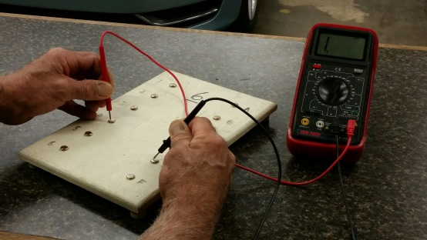
Ohms
Ohms Ω
Used for measuring resistance in a circuit through a load or to find out if a part of the circuit is connected to another.
Never when voltage is present!

Slide 11
DC Voltage
DC voltage flows in only one direction.

Slide 12
AC Voltage
AC voltage flows back and forth.

Slide 13
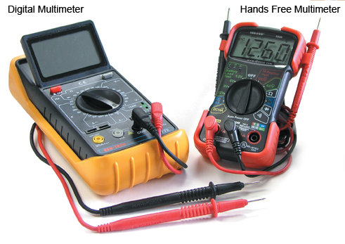
VOM Leads
Inspect VOM leads and determine how to hook up to VOM.
BLACK LEAD → Common Ground (-)
RED LEAD → Ω Volts Hz (+)

Slide 14
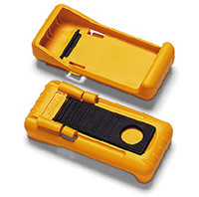
VOM Battery
Determine DVOM Battery Location
Inside back cover

Slide 15
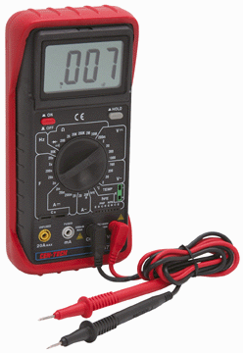
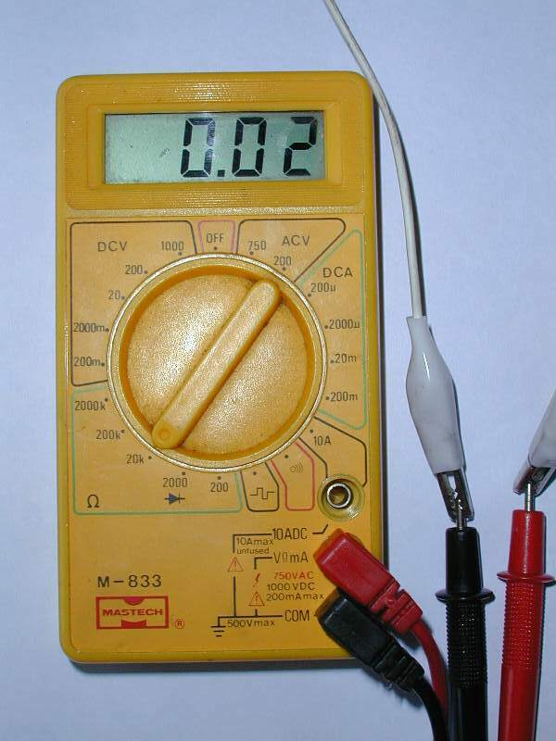
DVOM Scale
Always estimate what readings you anticipate getting and then set the meter to a value higher than what you are expecting to measure.

Slide 16
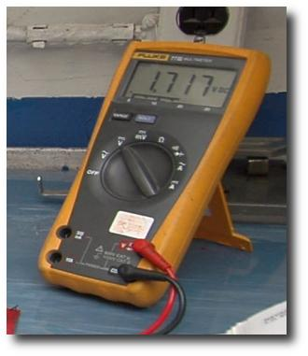
Meters that do not have adjustable range settings are called auto-ranging.

Slide 17

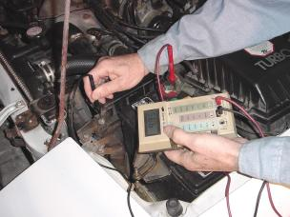
Automotive Use
What scale would you use to test the battery voltage of most cars?
20 V

Slide 18

Continuity
To test the continuity or “connectedness” of a circuit, you should use what scale?
Ohms

Slide 19

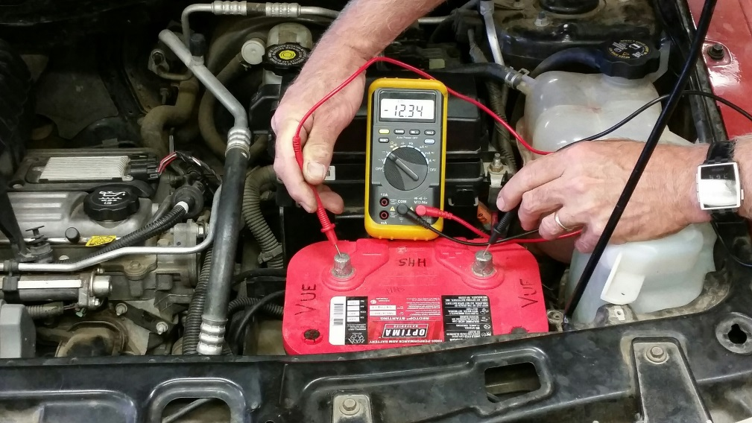
Continuity
You should never use which scale when the power is turned on or connected to the circuit?
Ohms

Slide 20
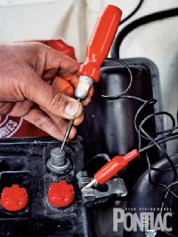
Draw Test
Milli-amp scales can be used for what test?
Draw Test

Slide 21
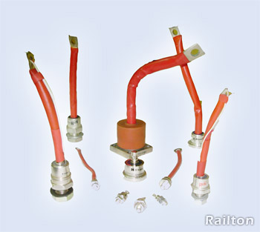
Diode
A Diode is a one way check valve for electricity.

Slide 22
Resistance
Define the following terms in relation to resistance (ohms):
Infinity = not connected
Open = not connected or “off”
Closed = connected or “on”
Shorted = Power to ground with no load

Slide 23
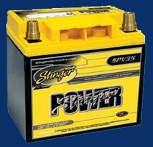
Car Battery
Car batteries are for storing electricity, but they do not produce it.

Slide 24
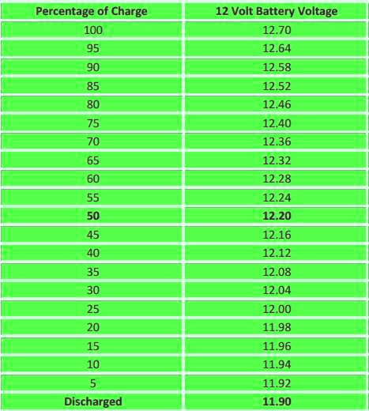
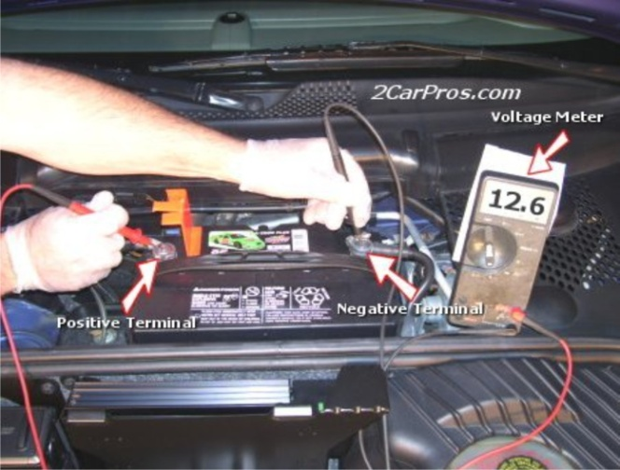
OPEN CIRCUIT VOLTAGE CHART for 12 Volt Battery
According to the chart at left, the battery in this picture above is about 92% full

Slide 25
Note the correlation between voltage and percentage full
DC Voltage
12.70 V
12.58 V
12.46 V
12.36 V
12.28 V
12.20 V
12.12 V
12.04 V
11.98 V
11.94V
11.90V
Percent Full | 0% | 10% | 20% | 30% | 40% | 50% | 60% | 70% | 80% | 90% | 100%

Slide 26

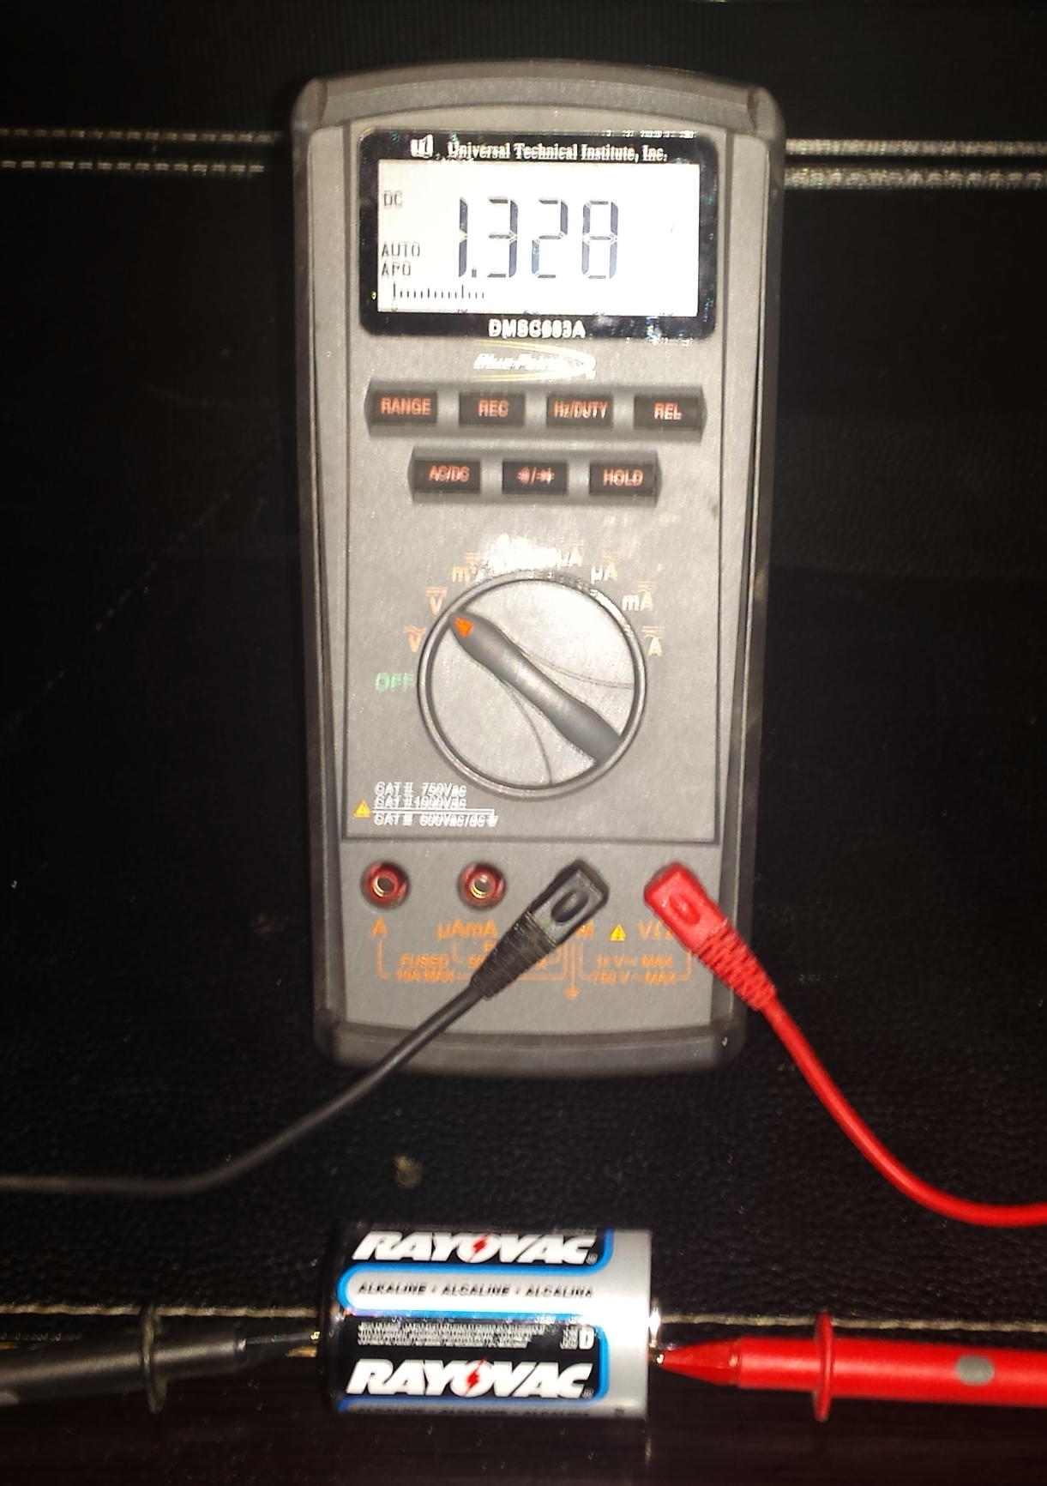
Measure the Voltage of a D cell Battery
Use V Scale

Slide 27
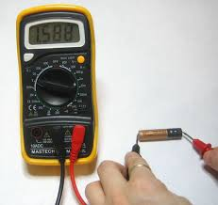
Measure the Voltage of a AA Battery
Use V Scale

Slide 28
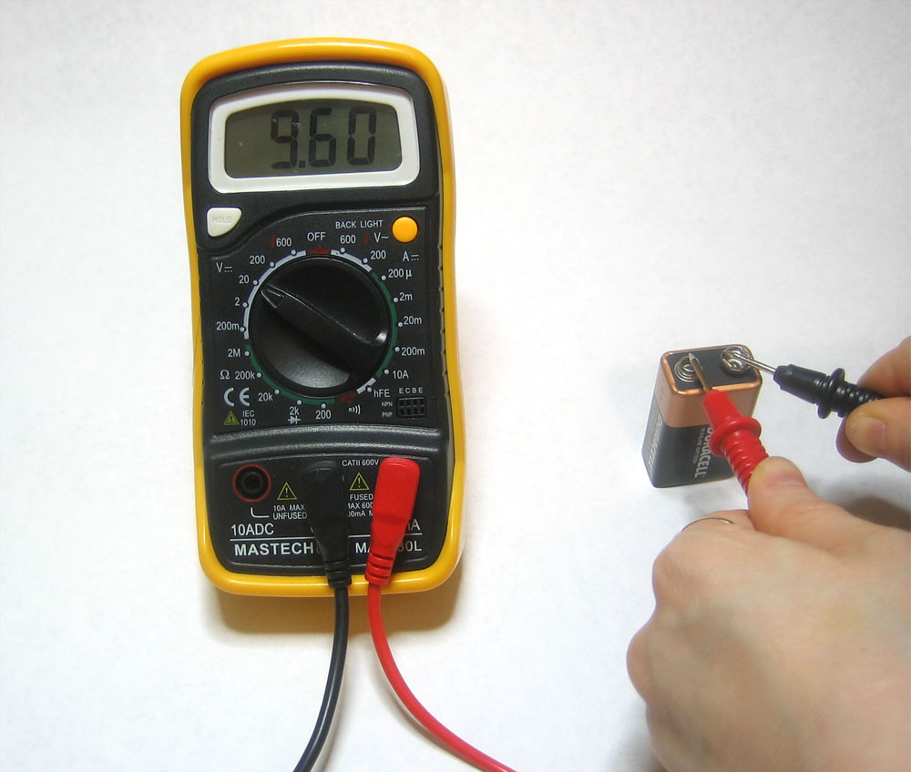
Measure the Voltage of a 9V Battery
Use V Scale
(or 20V some meters)

Slide 29
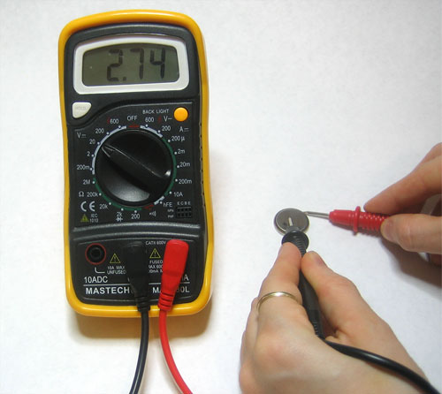
Measure the Voltage of a Button Battery
Use V Scale
(or 20V some meters)

Slide 30
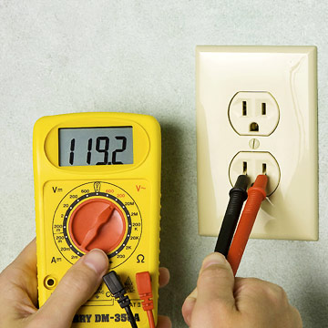
Measure the Voltage of a Wall Plug Outlet
Use V˜ Scale
(or 200V ˜ on some meters)

Slide 31
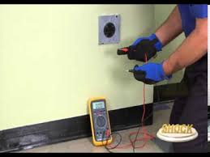
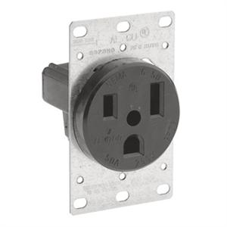
Measure the Voltage of a 240V Outlet
Use V˜ (AC) Scale
(or 700V ˜ on some meters)

Slide 32
Questions?
Watch this Power Point again
2. Ask three other students
3. See 1 and 2 above…
4. Google it!
Adrian Lallman alallman@hemetusd.org

